Slide 1

Unity 3D Essentials
Advanced Scripting Optimizations
SoftUni Team
Technical trainers
Software University
https://softuni.org

Slide 2

Table of Contents
Advanced Methods in Unity
Performance Techniques
Code Practices
Useful links

Slide 3
Have a Question?
sli.do
#Unity3D-Basics
Notes:
‹#›

Slide 4

Advanced Methods

Slide 5
Coroutines
private Coroutine moveCoroutine;
public bool IsAlive { get; set; } = true;
private void Start()
{
body = GetComponent<Rigidbody>();
moveCoroutine = StartCoroutine(MoveCoroutine());
}
private IEnumerator MoveCoroutine()
{
while (IsAlive)
{
body.AddRelativeForce(new Vector3(0, 0, speed), ForceMode.Acceleration);
yield return new WaitForFixedUpdate();
}
}

Slide 6
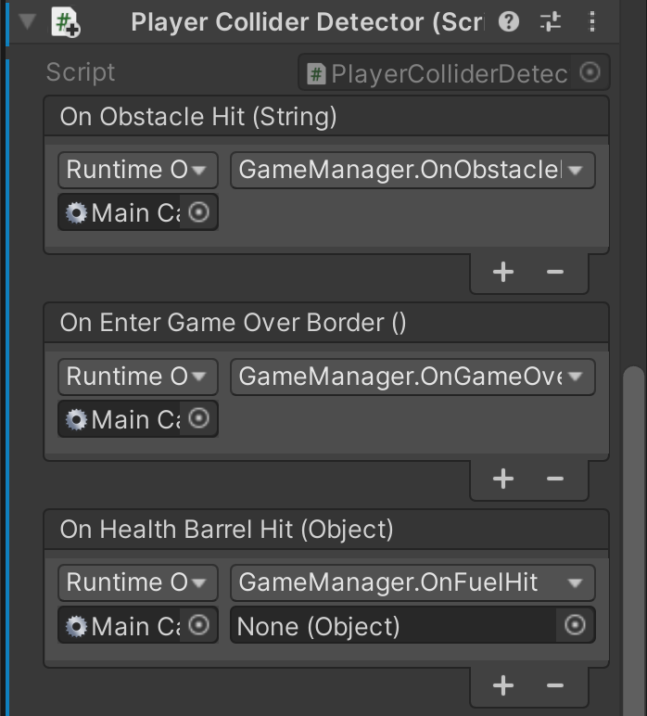
Unity Event
public UnityEvent<string> onObstacleHit;
private void OnCollisionEnter(Collision collision)
{
if (collision.gameObject.tag.Contains(“FuelBarrel”))
{
onObstacleHit.Invoke(collision.gameObject.name);
}
}

Slide 7

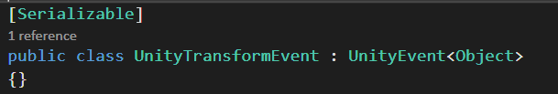
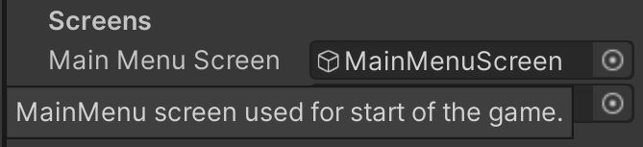
Editor Attributes
MenuItem (Hotkeys)
SerializeField
Serializable
Tooltip
Header
Range
ExecuteInEditMode

Slide 8
Player Prefs
uint highScore = (uint) PlayerPrefs.GetInt(ScoreString);
if (currentScore > highScore)
{
highScore = currentScore;
PlayerPrefs.SetInt(ScoreString, (int) currentScore);
}

Slide 9

Performance Optimizations

Slide 10
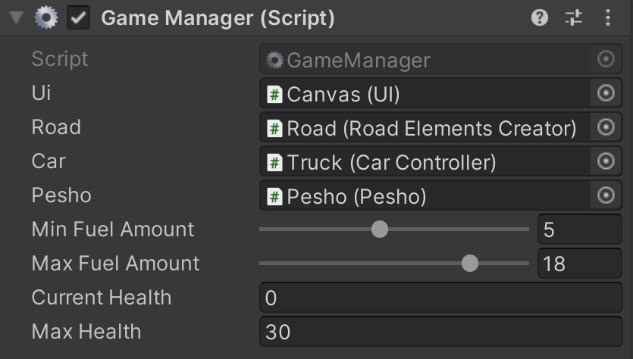
Game Manager logic
Why?
All business logic in one place
One object rules them all
Subscribe entry point
Decoupled independent scripts

Slide 11
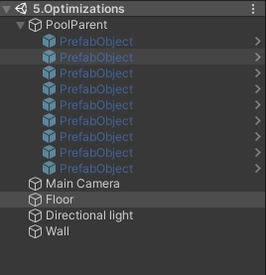
Object pooling
Why?
Pre-Made
Filled in at the Awake/Start
Dynamically add
Instantiate when empty

Slide 12
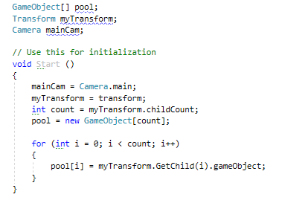
Cache components lookups
Why?
When?
GetComponent<>
Awake/Start

Slide 13
General Rules
Callings in the Update
OnBecameVisible
Lambda & Linq
Use same material across GOs
Keep layer collision matrix updated to your needs

Slide 14
General Rules
Bulk operations spread in frames
Coroutines
Always destroy (Deactivate) GO when not needed
Collections that have static size -> arrays

Slide 15

LAB

Slide 16
Useful Links
https://docs.unity3d.com/Manual/LogFiles.html
https://docs.unity3d.com/Manual/PlatformDependentCompilation.html
https://docs.unity3d.com/ScriptReference/MenuItem.html
https://www.youtube.com/c/InfallibleCode
Performance recommendations for Unity

Slide 17

Summary
Advanced Methods in Unity
Performance Techniques
Code Practices
Useful links
Notes:
‹#›

Slide 18
Questions?
Email : dstrashilov@gmail.com
Notes:
‹#›

Slide 19

License
This course (slides, examples, demos, exercises, homework, documents, videos and other assets) is copyrighted content
Unauthorized copy, reproduction or use is illegal
© SoftUni – https://about.softuni.bg
© Software University – https://softuni.bg
Notes:
‹#›

Slide 20
Trainings @ Software University (SoftUni)
Software University – High-Quality Education, Profession and Job for Software Developers
about.softuni.bg, softuni.org
Software University Foundation
softuni.foundation
Software University @ Facebook
facebook.com/SoftwareUniversity
Software University Forums
forum.softuni.bg
Notes:
‹#›

